Slide 1

Database Systems:
Design, Implementation, and Management
Tenth Edition
Chapter 12
Distributed Database Management Systems

Slide 2
Objectives
In this chapter, you will learn:
About distributed database management systems (DDBMSs) and their components
How database implementation is affected by different levels of data and process distribution
How transactions are managed in a distributed database environment
Database Systems, 10th Edition

Slide 3
Objectives (cont’d.)
How distributed database design draws on data partitioning and replication to balance performance, scalability, and availability
About the trade-offs of implementing a distributed data system
Database Systems, 10th Edition

Slide 4
The Evolution of Distributed Database Management Systems
Distributed database management system (DDBMS)
  Governs storage and processing of logically related data
  Interconnected computer systems
  Both data and processing functions are distributed among several sites
Centralized database required that corporate data be stored in a single central site
Database Systems, 10th Edition

Slide 5
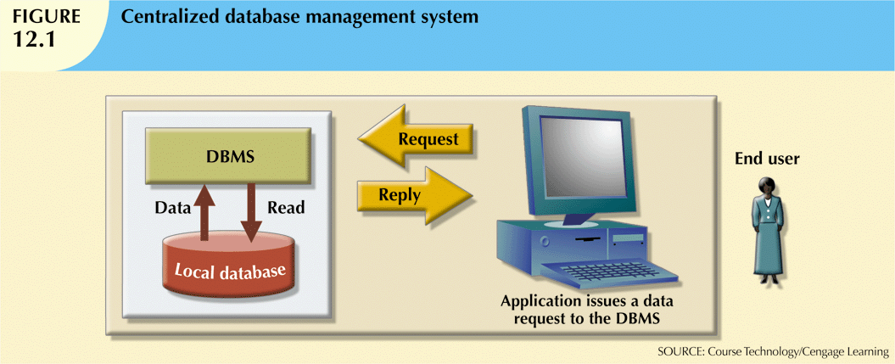
Database Systems, 10th Edition

Slide 6
DDBMS Advantages and Disadvantages
Advantages:
  Data are located near “greatest demand” site
  Faster data access
  Faster data processing
  Growth facilitation
  Improved communications
  Reduced operating costs (questionable)
  User-friendly interface
  Less danger of a single-point failure
  Processor independence
Database Systems, 10th Edition

Slide 7
DDBMS Advantages and Disadvantages (cont’d.)
Disadvantages:
  Complexity of management and control
  Security
  Lack of standards
  Increased storage requirements
  Increased training cost
  Costs (duplicate hardware, licensing, etc.)
  User-friendly interface a necessity
Database Systems, 10th Edition

Slide 8
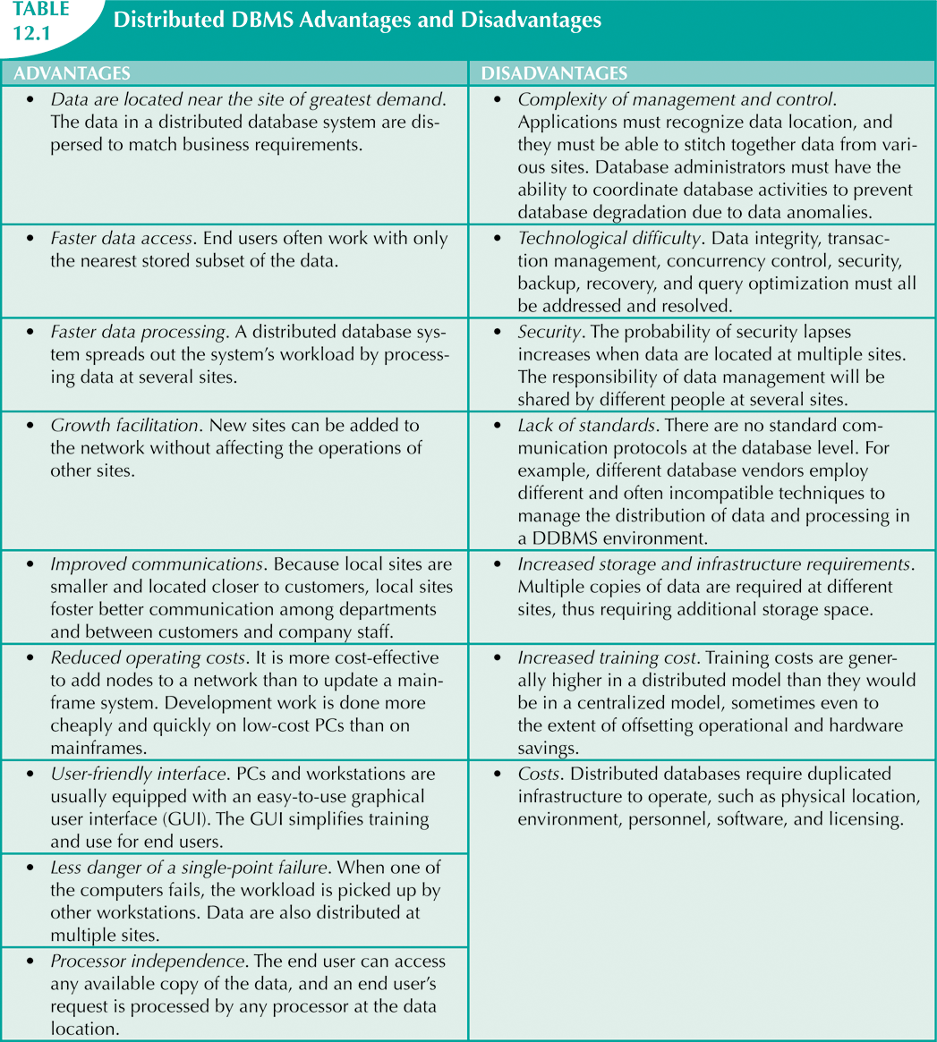
Database Systems, 10th Edition

Slide 9
Distributed Processing and Distributed Databases
Distributed processing
  Database’s logical processing is shared among two or more physically independent sites
  Connected through a network
Distributed database
  Stores logically related database over two or more physically independent sites
  Database composed of database fragments
Database Systems, 10th Edition

Slide 10
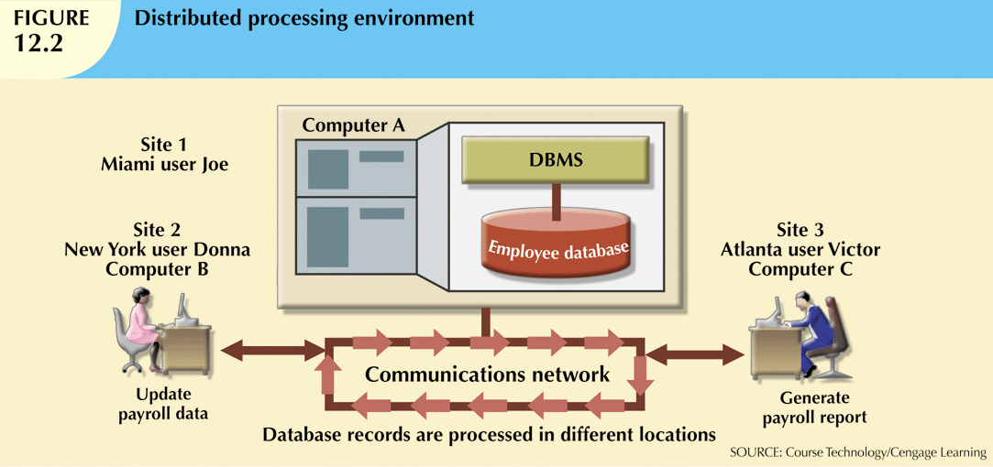
Database Systems, 10th Edition

Slide 11
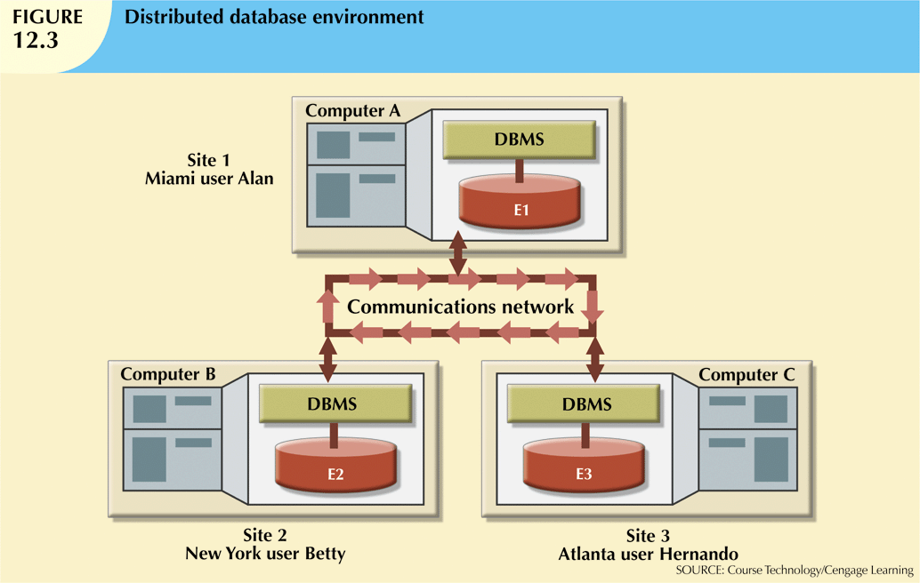
Database Systems, 10th Edition

Slide 12
Characteristics of Distributed Management Systems
Application interface
Validation
Transformation
Query optimization
Mapping
I/O interface
Database Systems, 10th Edition

Slide 13
Characteristics of Distributed Management Systems (cont’d.)
Formatting
Security
Backup and recovery
DB administration
Concurrency control
Transaction management
Database Systems, 10th Edition

Slide 14
Characteristics of Distributed Management Systems (cont’d.)
Must perform all the functions of centralized DBMS
Must handle all necessary functions imposed by distribution of data and processing
  Must perform these additional functions transparently to the end user
Database Systems, 10th Edition

Slide 15
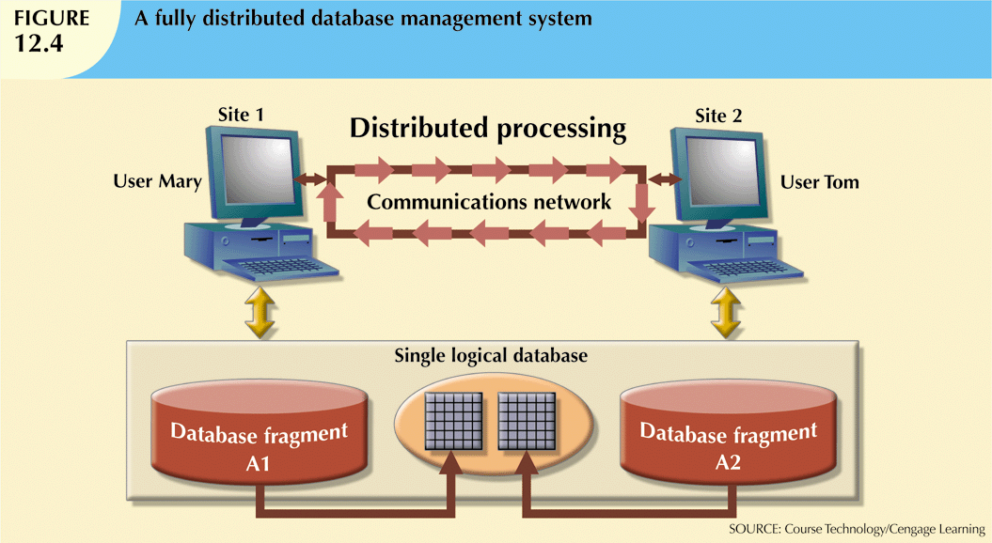
Database Systems, 10th Edition

Slide 16
DDBMS Components
Must include (at least) the following components:
  Computer workstations
  Network hardware and software
  Communications media
  Transaction processor (application processor, transaction manager)
    Software component found in each computer that requests data
  Data processor or data manager
    Software component residing on each computer that stores and retrieves data located at the site
    May be a centralized DBMS
Database Systems, 10th Edition

Slide 17
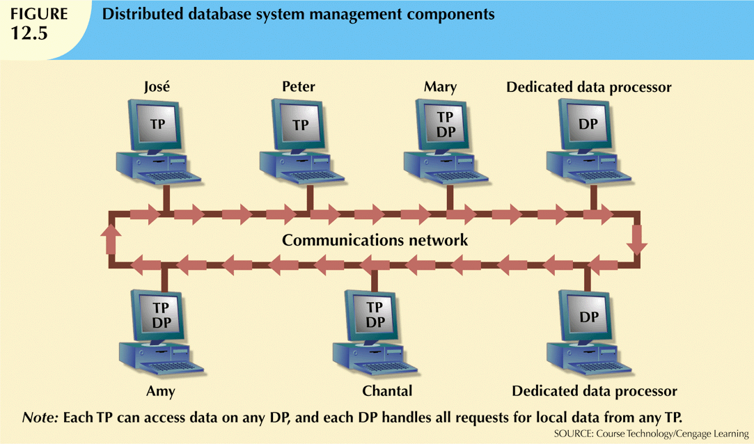
Database Systems, 10th Edition

Slide 18
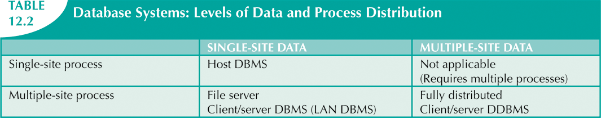
Levels of Data and Process Distribution
Current systems classified by how process distribution and data distribution are supported
Database Systems, 10th Edition

Slide 19
Single-Site Processing,
Single-Site Data
All processing is done on single CPU or host computer (mainframe, midrange, or PC)
All data are stored on host computer’s local disk
Processing cannot be done on end user’s side of system
Typical of most mainframe and midrange computer DBMSs
DBMS is located on host computer, which is accessed by dumb terminals connected to it
Database Systems, 10th Edition

Slide 20
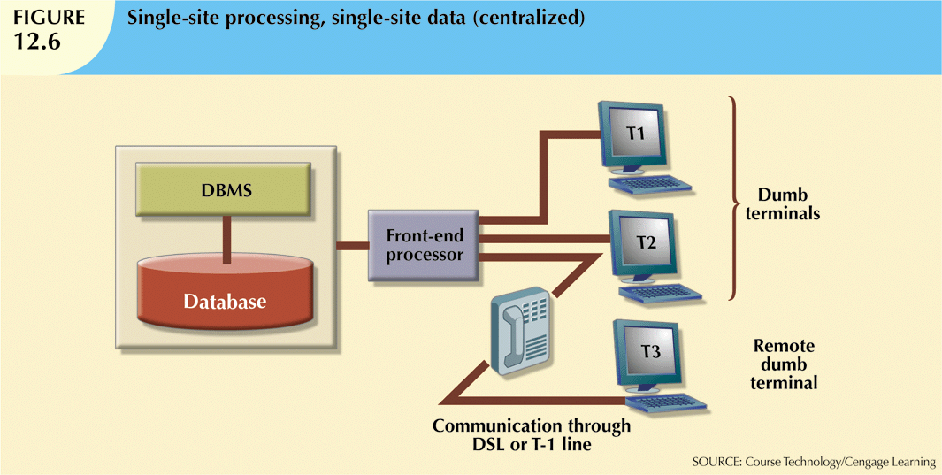
Database Systems, 10th Edition

Slide 21
Multiple-Site Processing,
Single-Site Data
Multiple processes run on different computers sharing single data repository
MPSD scenario requires network file server running conventional applications
  Accessed through LAN
Many multiuser accounting applications, running under personal computer network
Database Systems, 10th Edition

Slide 22
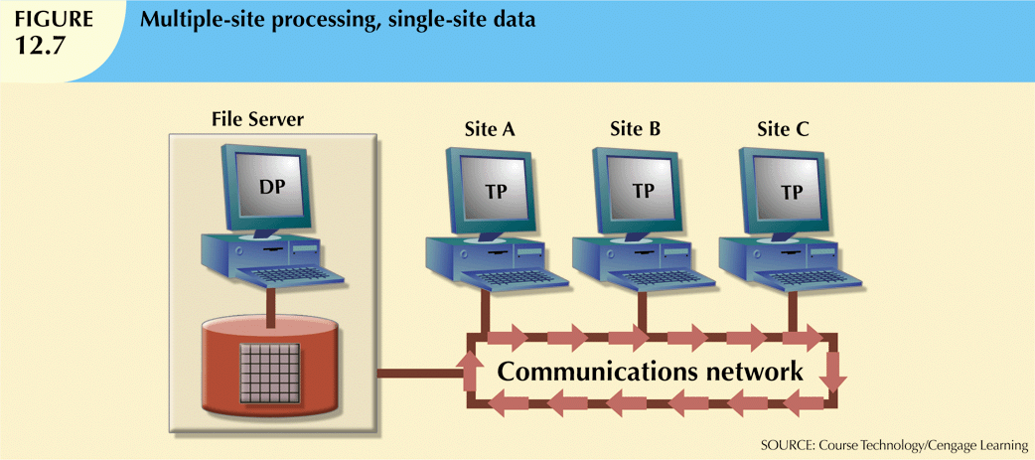
Database Systems, 10th Edition

Slide 23
Multiple-Site Processing,
Multiple-Site Data
Fully distributed database management system
Support for multiple data processors and transaction processors at multiple sites
Classified as either homogeneous or heterogeneous
Homogeneous DDBMSs
  Integrate only one type of centralized DBMS over a network
Database Systems, 10th Edition

Slide 24

Multiple-Site Processing,
Multiple-Site Data (cont’d.)
Heterogeneous DDBMSs
  Integrate different types of centralized DBMSs over a network
Fully heterogeneous DDBMSs (Goal)
  Support different DBMSs
  Support different data models (relational, hierarchical, or network)
  Different computer systems, such as mainframes and microcomputers
Database Systems, 10th Edition

Slide 25
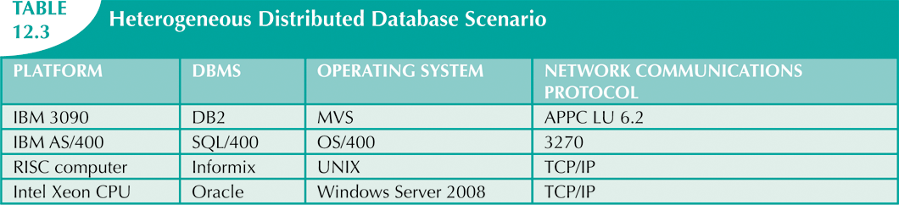
Database Systems, 10th Edition

Slide 26
Distributed Database
Transparency Features
Allow end user to feel like database’s only user
Features include:
  Distribution transparency (from slide 27)
  Transaction transparency (from slide 29)
  Failure transparency (from slide 34)
  Performance transparency (from slide 34)
  Heterogeneity transparency (refer to slide 24)
Database Systems, 10th Edition

Slide 27
Distribution Transparency
Allows management of physically dispersed database as if centralized
Three levels of distribution transparency:
  Fragmentation transparency
  Location transparency
  Local mapping transparency
Database Systems, 10th Edition

Slide 28
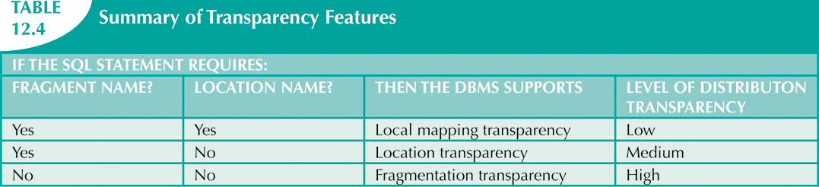
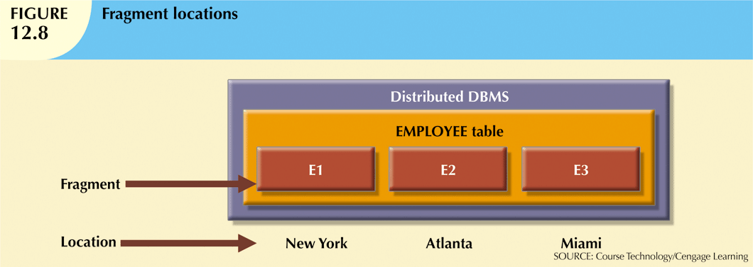
Database Systems, 10th Edition

Slide 29
Transaction Transparency
Ensures database transactions will maintain distributed database’s integrity and consistency
Ensures transaction completed only when all database sites involved complete their part
Distributed database systems require complex mechanisms to manage transactions
  To ensure consistency and integrity
Database Systems, 10th Edition

Slide 30
Distributed Requests and Distributed Transactions
Remote request: single SQL statement accesses data from single remote database
Remote transaction: accesses data at single remote site
Distributed transaction: requests data from several different remote sites on network
Distributed request: single SQL statement references data at several DP sites
Database Systems, 10th Edition

Slide 31
Distributed Concurrency Control
Concurrency control is important in distributed environment
  Multisite multiple-process operations create inconsistencies and deadlocked transactions
Database Systems, 10th Edition

Slide 32
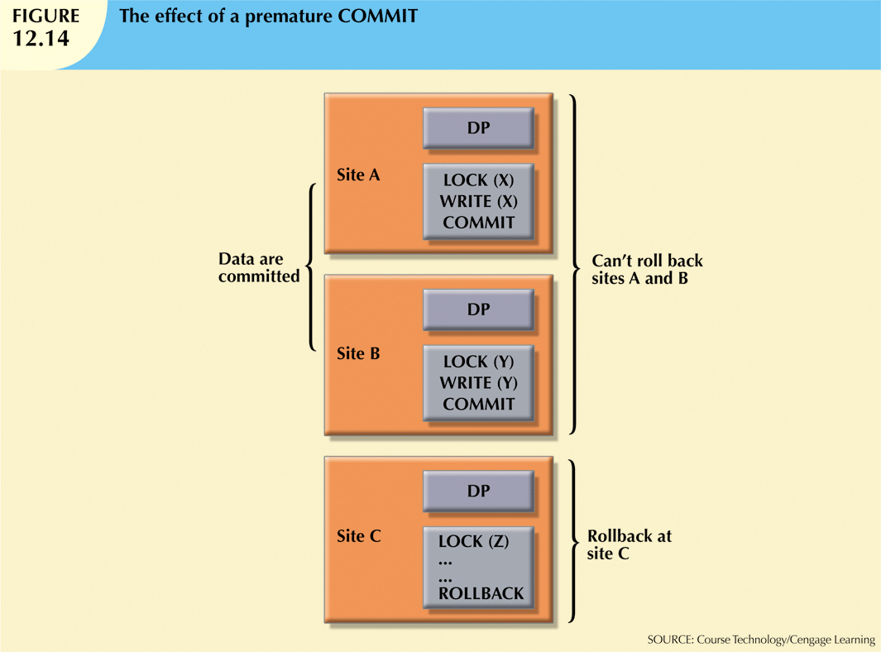
Database Systems, 10th Edition

Slide 33
Two-Phase Commit Protocol
Distributed databases make it possible for transaction to access data at several sites
Final COMMIT is issued after all sites have committed their parts of transaction
Requires that each DP’s transaction log entry be written before database fragment updated
DO-UNDO-REDO protocol with write-ahead protocol
Defines operations between coordinator and subordinates
Database Systems, 10th Edition

Slide 34
Performance and Failure Transparency
Performance transparency
  Allows a DDBMS to perform as if it were a centralized database
Query optimization
  Minimize the total cost associated with the execution of a request
Replica transparency
  DDBMS’s ability to hide multiple copies of data from the user
Database Systems, 10th Edition

Slide 35
Performance and Failure Transparency (cont’d.)
Network latency
  Delay imposed by the amount of time required for a data packet to make a round trip from point A to point B
Network partitioning
  Delay imposed when nodes become suddenly unavailable due to a network failure
Database Systems, 10th Edition

Slide 36
Performance Transparency and Query Optimization
Query optimization routine minimizes total cost of request
Costs a function of:
  Access time (I/O) cost
  Communication cost
  CPU time cost
Must provide distribution transparency as well as replica transparency
Database Systems, 9th Edition

Slide 37
Performance Transparency and Query Optimization (cont’d.)
Replica transparency
  DDBMS’s ability to hide existence of multiple copies of data from user
Query optimization:
  Manual or automatic
  Static or dynamic
  Statistically based or rule-based algorithms
Database Systems, 9th Edition

Slide 38
Distributed Database Design
Data fragmentation
  How to partition database into fragments
Data replication
  Which fragments to replicate
Data allocation
  Where to locate those fragments and replicas
Database Systems, 10th Edition

Slide 39
Data Fragmentation
Breaks single object into two or more segments or fragments
Each fragment can be stored at any site over computer network
Information stored in distributed data catalog (DDC)
  Accessed by TP to process user requests
Database Systems, 10th Edition

Slide 40
Data Fragmentation (cont’d.)
Strategies
  Horizontal fragmentation
    Division of a relation into subsets (fragments) of tuples (rows)
  Vertical fragmentation
    Division of a relation into attribute (column) subsets
  Mixed fragmentation
    Combination of horizontal and vertical strategies
Database Systems, 10th Edition

Slide 41

Data Replication
Data copies stored at multiple sites served by computer network
Fragment copies stored at several sites to serve specific information requirements
  Enhance data availability and response time
  Reduce communication and total query costs
Mutual consistency rule: all copies of data fragments must be identical
Database Systems, 10th Edition

Slide 42
Data Replication (cont’d.)
Fully replicated database
  Stores multiple copies of each database fragment at multiple sites
  Can be impractical due to amount of overhead
Partially replicated database
  Stores multiple copies of some database fragments at multiple sites
Unreplicated database
  Stores each database fragment at single site
  No duplicate database fragments
Database Systems, 10th Edition

Slide 43
Data Allocation
Deciding where to locate data
  Centralized data allocation
    Entire database is stored at one site
  Partitioned data allocation
    Database is divided into several disjointed parts (fragments) and stored at several sites
  Replicated data allocation
    Copies of one or more database fragments are stored at several sites
Database Systems, 10th Edition

Slide 44
The CAP Theorem
Initials CAP stand for three desirable properties
  Consistency (see, also, ch 10 sec 1.2)
  Availability
  Partition tolerance
Basically available, soft state, eventually consistent (BASE)
  Data changes are not immediate but propagate slowly through the system until all replicas are eventually consistent
Database Systems, 10th Edition

Slide 45
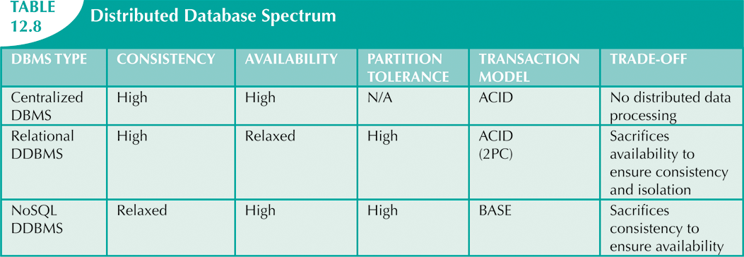
Database Systems, 10th Edition

Slide 46
C. J. Date’s Twelve Commandments for Distributed Databases
Local site independence
Central site independence
Failure independence
Location transparency
Fragmentation transparency
Replication transparency
Key on the 2 words which repeat across these 2 slides.
Database Systems, 10th Edition

Slide 47
C. J. Date’s Twelve Commandments for Distributed Databases (cont’d.)
Distributed query processing
Distributed transaction processing
Hardware independence
Operating system independence
Network independence
Database independence
Key on the 2 words which repeat across these 2 slides.
Database Systems, 10th Edition

Slide 48
Summary
Distributed database: logically related data in two or more physically independent sites
  Connected via computer network
Distributed processing: division of logical database processing among network nodes
Distributed databases require distributed processing
Main components of DDBMS are transaction processor and data processor
Database Systems, 10th Edition

Slide 49
Summary (cont’d.)
Current distributed database systems
  SPSD, MPSD, MPMD
Homogeneous distributed database system
  Integrates one type of DBMS over computer network
Heterogeneous distributed database system
  Integrates several types of DBMS over computer network
Database Systems, 10th Edition

Slide 50
Summary (cont’d.)
DDBMS characteristics are a set of transparencies
Transaction is formed by one or more database requests
Distributed concurrency control is required in network of distributed databases
Distributed DBMS evaluates every data request
  Finds optimum access path in distributed database
Database Systems, 10th Edition

Slide 51
Summary (cont’d.)
The design of distributed database must consider fragmentation and replication of data
Database can be replicated over several different sites on computer network
Database Systems, 10th Edition

